Slide 1
Data Science Bootcamp
1st Meeting
Rutgers Statistics Club x Cognitive Science Club

Slide 2
WELCOME!

Slide 3
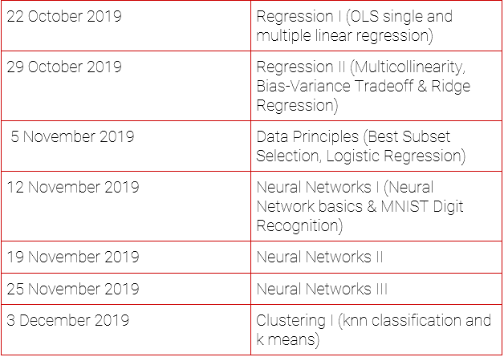
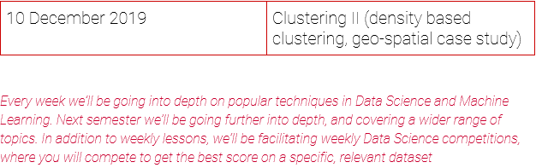

Slide 4
IDE info
You can either use google colab
Or use your own python IDE

Slide 5
Linear Regression

Slide 6
What, Why & When
What:
Linear Regression is a supervised learning tool which is useful for predicting a quantitative response.
Why (are you learning this):
Because linear regression is still useful, in fact it’s the most commonly used machine learning tool out there. Furthermore, it serves as a good starter for newer approaches; many statistical learning approaches can be seen as generalizations or extensions of linear regression.
When (do I use this):
Is there a relationship between X&Y
How strong is the relationship between X&Y
How well can I estimate X&Y
Etc, etc
Notes:
What is supervised learning?
Supervised learning algos work to make predictions on data when we have some sample where we already know what the outcomes are.

Slide 7
Simple Linear Regression Example
Simple, single variable linear regression
We’re going to use X, the independent variable to predict Y, the dependent variable.
Dataset: x,y = (0,1),(2,2),(3,3),(4,3.75)
How well would we fit this if we did….
Y = x+1?
Notes:
Independent vs Dependent:
y = f(x)

Slide 8

Simple Linear Regression | Cost functions
Definitions:
Residual = y_{act}-y_{hat}
RSS = sum of residuals squared

Slide 9
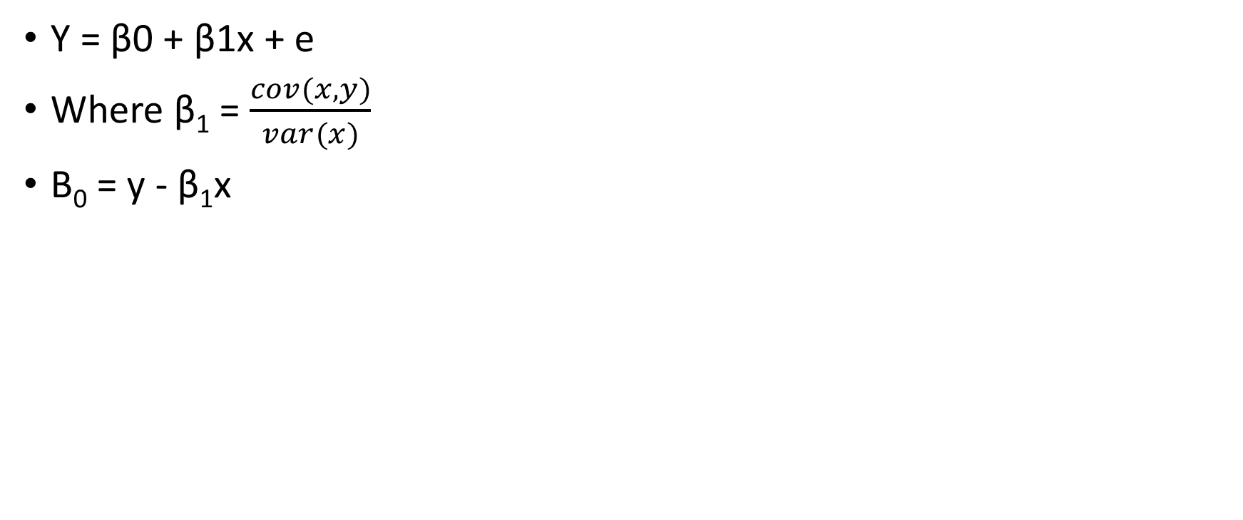
Ordinary Least Squares Regression
This minimizes RSS
(I’ll talk about unbiasedness here)

Slide 10
Evaluating our Model
Going back to our when (do I use this):
To determine if there is a relationship between Y and X:
We find the pvalue for how significant B1 is.
To determine how strong the relationship is:
We see the value of B1
To determine how well we can predict Y using X:
We use R^2, the coefficient of determination
Important! Intercept may or may not have meaning

Slide 11
Let’s Practice (Boston Housing)

Slide 12
Multiple Linear Regression Model
We now add multiple Xi’s (i = 1,2…,n) in linear model to get a better fit.
However now we have to use an Fscore to determine if the model is signficant.

Slide 13

Join the GroupMe

